Slide 1
The LPHN3 gene in ADHD
Sean Brennan
Notes:
Eddie Ruiz: Find a better resolution image? Does this image really relate to ADHD? For the title, perhaps write “The LPHN3 *gene* in ADHD. “
Image: https://i.ytimg.com/vi/VIcGRffuMLg/maxresdefault.jpg

Slide 2
How is LPHN3 related to ADHD?
Downregulation of LPHN3 and SNPs in LPHN3 cause ADHD like symptoms
Notes:
Eddie Ruiz: How is LPHN3 GENE related to ADHD? What is this figure? Could a video or animation give more sense of ADHD’s relation to LPHN3
Increase the size of the font at the bottom.

Slide 3
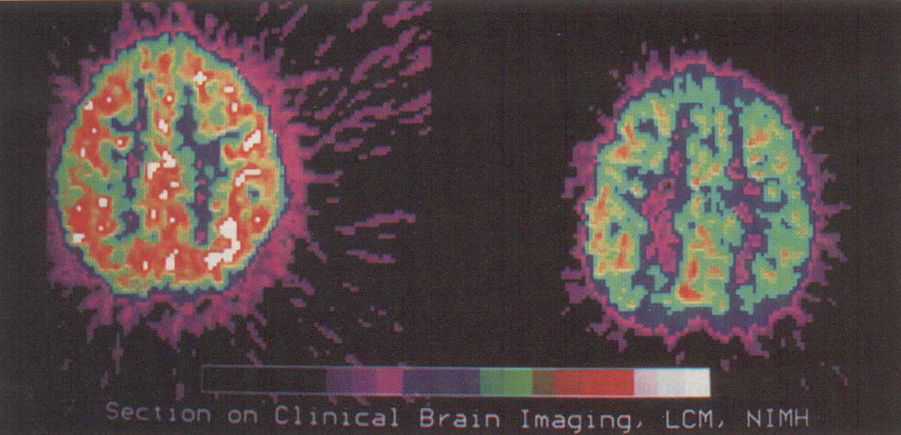
Attention Deficit/Hyperactivity Disorder
Notes:
http://m3.wyanokecdn.com/9486c001dbb012b594a1a71abdd952d0.jpg

Slide 4
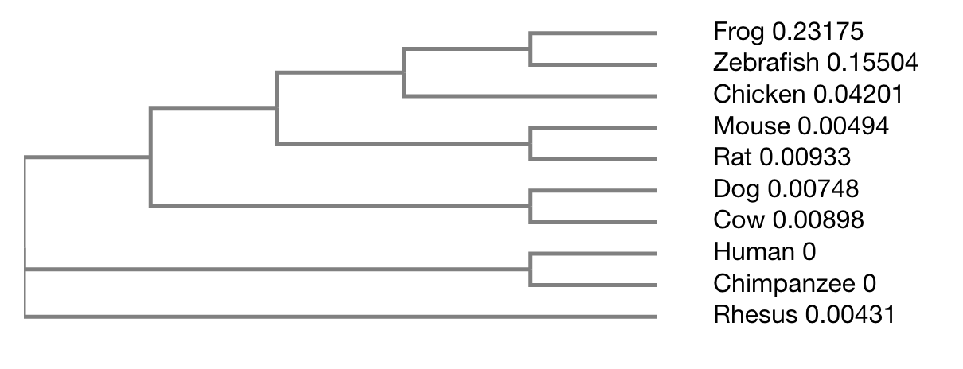

Slide 5
How well is LPHN3 conserved?
Human
Gal Lectin
OLF
HR
GAIN
GPS
7-Transmembrane
Latrophilin
1469aa
Mouse
Gal Lectin
OLF
HR
GAIN
GPS
7-Transmembrane
Latrophilin
1543aa
Gal Lectin
HR
GAIN
GPS
7-Transmembrane
Latrophilin
1580aa
Dog
Gal Lectin
OLF
Latrophilin
Gal Lectin
HR
GAIN
GPS
7-Transmembrane
Latrophilin
1304aa
Zebra Fish
Gal Lectin
OLF
Peptidase
Gal Lectin
HR
GAIN
GPS
7-Transmembrane
Latrophilin
1540aa
Frog
Gal Lectin
OLF
Latrophilin
LPHN3 domains are highly conserved among model organisms!
Notes:
Eddie Ruiz: Make the name of the species bold or larger? LPHN3 Homology

Slide 6
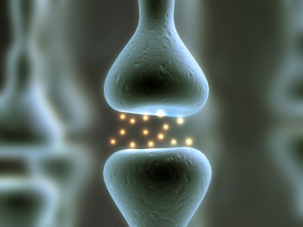
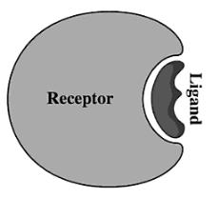
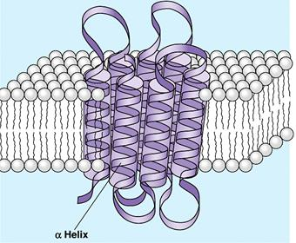
Genetic association to ADHD
Human
Gal Lectin
OLF
HR
GAIN
GPS
7-Transmembrane
Latrophilin
1469aa
Biological Processes
Neural Synapses
Cell signaling
Molecular Function
Ligand Binding Domain
Cellular Component
Intracellular
7 transmembrane region
Extracellular
Notes:
Eddie Ruiz: The image appears to be squished.
Try bolding the headers of each point (e.g. Biological Proceses)

Slide 7
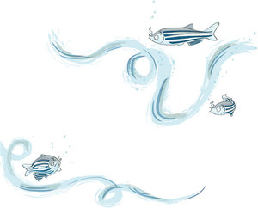
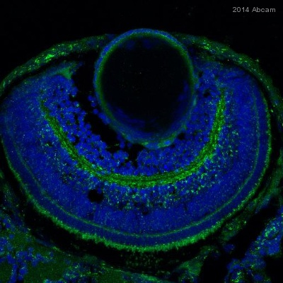
Why use Zebrafish?
Human
Gal Lectin
OLF
HR
GAIN
GPS
7-Transmembrane
Latrophilin
1469aa
Gal Lectin
HR
GAIN
GPS
7-Transmembrane
Latrophilin
1304aa
Zebra Fish
Gal Lectin
OLF
Peptidase
Notes:
http://a.abcam.com/ps/products/18/ab18258/Images/ab18258-233573-ab18258ihcf.jpg

Slide 8
Primary Goal: to better understand how LPHN3 plays a role in neurological synaptic density
I hypothesize that synaptic density can be recovered in LPHN3 mutants.
Specific Aims 1: Identify domains in LPHN3 that influence synaptic density.
Specific Aims 2: Discover small molecules that can recover synaptic density in LPHN3 mutant domains previously identified.
Specific Aims 3:
My long-term goal is to discover a new way to treat ADHD patients with mutant LPHN3 phenotypes.

Slide 9
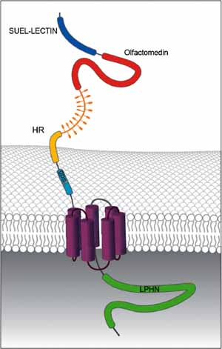
Aim 1: Identify domains in LPHN3 crucial to synaptic density.
SMART, PFAM, Clustal Omega
Notes:
https://www.researchgate.net/profile/Horia_Stanescu/publication/49708199/figure/fig2/AS:282643489935384@1444398867663/Figure-1-Schematic-representation-of-the-two-subunits-of-the-LPHN3-protein-NTF.png

Slide 10
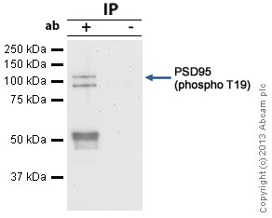
Aim 1: Identify domains in LPHN3 crucial to synaptic density.
Gal Lectin
HR
GAIN
GPS
7-Transmembrane
Latrophilin
1304aa
Zebra Fish
Gal Lectin
OLF
Peptidase
CRISPR-Cas9
Measure synaptic density
(using psd-95)
Notes:
http://biotech-spain.com/files/media/image/articles/2016/01/original/2494zebra.jpg

Slide 11
Aim 1: Identify domains in LPHN3 crucial to synaptic density.
I hypothesize that the hormone receptor and other extracellular domains will have the greatest effect on synaptic density.
Notes:
https://www.researchgate.net/profile/Horia_Stanescu/publication/49708199/figure/fig2/AS:282643489935384@1444398867663/Figure-1-Schematic-representation-of-the-two-subunits-of-the-LPHN3-protein-NTF.png

Slide 12
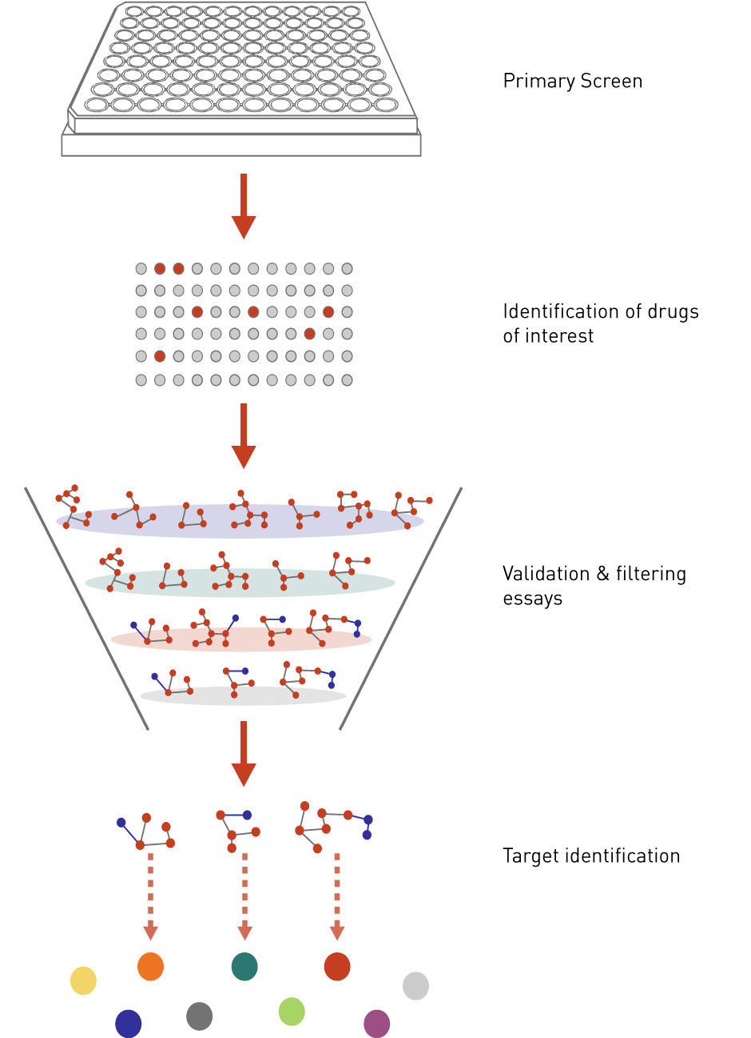
Aim 2: Discover small molecules that can recover synaptic density in LPHN3 mutant domains previously identified.
Notes:
http://a.abcam.com/ps/products/16/ab16496/Images/PSD95-Primary-antibodies-ab16496-24.jpg

Slide 13
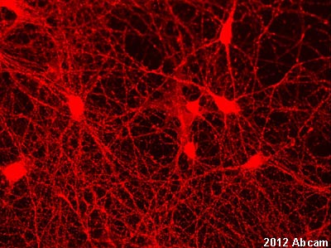
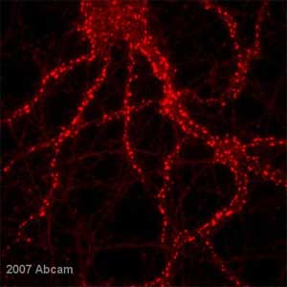
Aim 2: Discover small molecules that can recover synaptic density in LPHN3 mutant domains previously identified.
Notes:
http://a.abcam.com/ps/products/2/ab2723/Images/ab2723_2.jpg

Slide 14
Figures:
Slide 1. https://assets.rebelcircus.com/blog/wpcontent/uploads/2016/02/32413.jpg
Slide 2. http://www.akidjustlikeme.com/1d0c2460.jpg
Slide 3. http://www.nature.com/mp/journal/v17/n9/full/mp2012119a.html
Slide 4. https://www.degruyter.com/view/j/tnsci.2016.7.issue-1/tnsci-2016-0004/graphic/j_tnsci-2016- 0004_fig_002.jpg
References:

